Slide 1

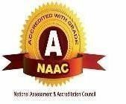
UV Lights and Lamps: Ultraviolet-C Radiation, Disinfection, and Coronavirus
Presented by, Siddiq Bala. B Subash. B Wasim Ansari. N Yuvan Shankar. N S
714019106104
714019106110
714019106133
714019106136
Guided by,
Mr .T.Maheshwaran,
Associate Professor

Slide 2
PROBLEM STATEMENT OVERVIEW
Covid19 took humankind by surprise in 2020. Due to its fast and efficiently spreading nature, we were forced to use face masks and gloves to protect from everything we touch.
Well we can use masks to protect us outside but what about the things we bring home from market or things we exchange with other people.
For example: We cannot apply sanitizers on cell phones, cash or paperwork. paper work that doctors exchange with patients or employees exchange with each other.
sanitizer usage involves use of chemicals that are harmful to us and the environment as well as it involves recurring cost of buying sanitizers.

Slide 3
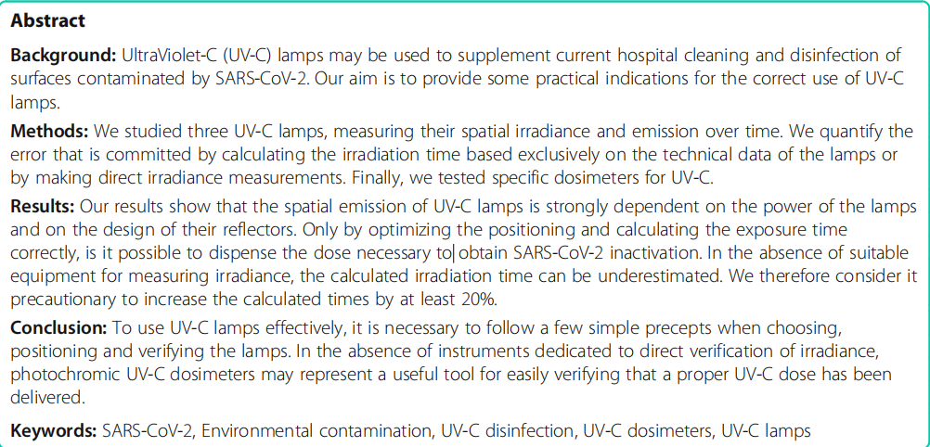
EXISTING WORK

Slide 4
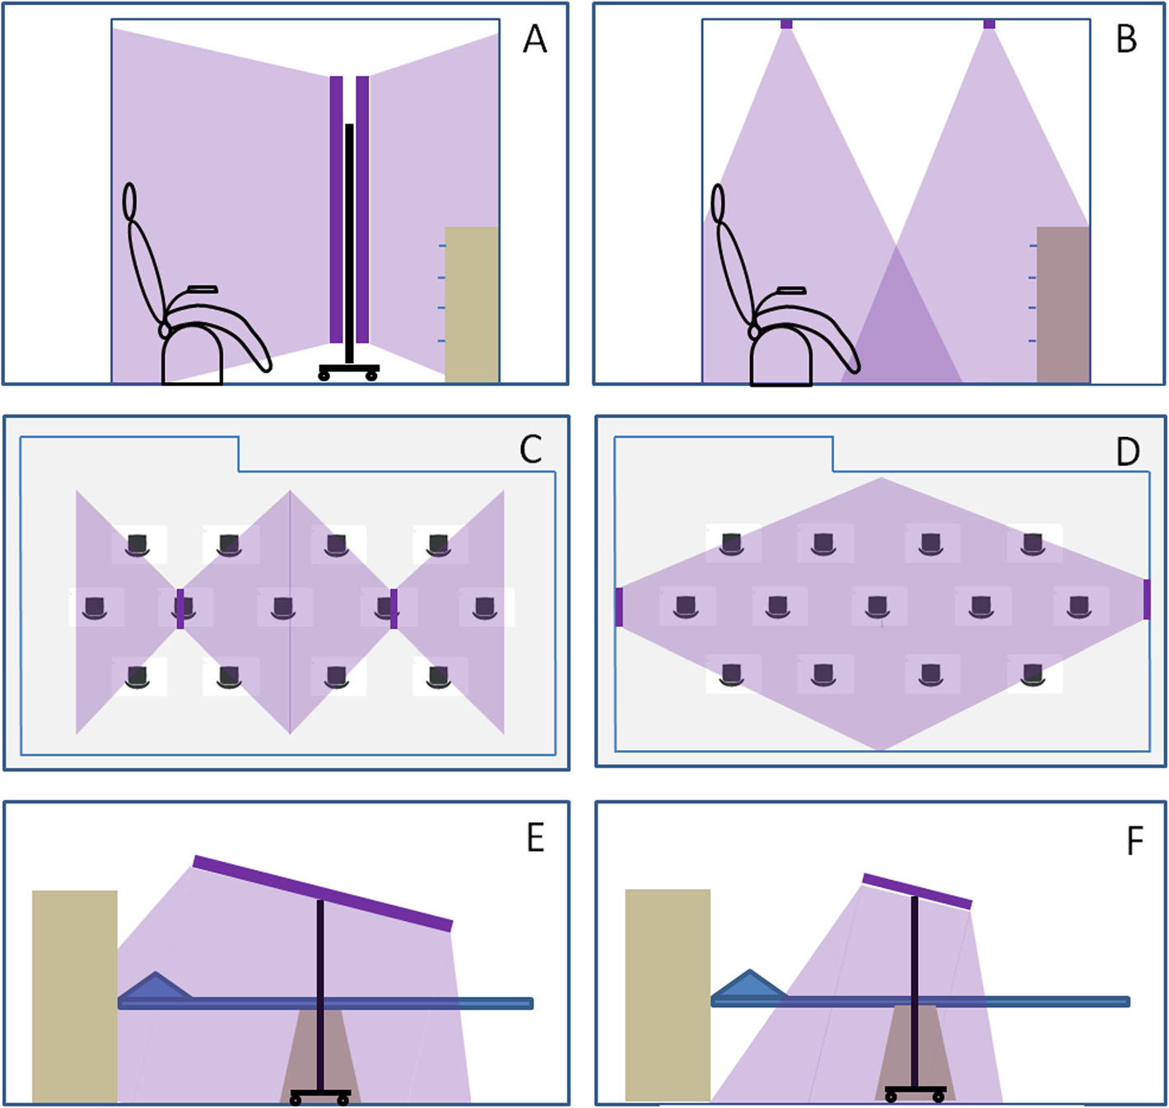
EXISTING WORK MODEL

Slide 5
PROPOSED WORK
Well we solve this huge problem with a smart electronics system powered by a microcontroller.
We design a compact 360 degree disinfection box using ultraviolet sterilization to solve the issue. The system makes use of uV-c tubes to achieve this task.
UV-C energy passes through the cell walls of bacteria, viruses and bacterial spores & it is absorbed by the DNA, RNA and proteins.
Once the DNA is fused, the organism can no longer replicate and is, therefore, no longer infectious. The technical term for this is "deactivation.

Slide 6
ADVANTAGES
Dry Sterilization Without Water or Chemicals
360 Degree Sterilization
Proven for Bacteria and Virus Deactivation
Adjustable Sterilization Time

Slide 7
OBJECTIVE
Ultra Violet radiation, Chlorination, washing with soap and heating are some methods of sterilizing. Ultra Violet light is the best sterilizing and disinfectant agent, used for domestic as well as clinical purpose. Food packets, books, stationery, medical equipments, toys, electronic gadgets like mobile phones, laptops, wrist watches, etc.. can be sterilized with UV radiation whereas other methods of sterilization cannot be used. UV light does not release any waste and is eco-friendly, if used in a controlled manner. UV radiation is a range of electromagnetic waves with shorter wavelength (high frequency and energy). The wavelength from 100-280 nm known as UV-C is the best disinfectant used for purifying water, air, sterilizing vegetables and surgical equipments. Research has shown that UV-C wavelength can kill harmful fungi, protozoa, bacteria and viruses like SARS-CoV-2 Virus. The article describes the construction of a low cost UV-C Sterilizer Box where UV radiation is taking place in a closed environment. Safety features are also incorporated to prevent humans from UV light exposure. So we design automatic.

Slide 8
REFERENCE
https://www.ncbi.nlm.nih.gov/pmc/articles/PMC7571309/
https://www.cdc.gov/infectioncontrol/guidelines/disinfection/disinfection-methods/miscellaneous.html

